Slide 1
INTRODUCTION TO COMPUTING
Course Code: CCINCOM/L
Review in Probability, Intro to RL Concepts
Elizer Ponio Jr
Faculty Member
Department of Computer Science
College of Computing and Information Technologies (CCIT)
National University
Joseph Marvin R. Imperial
REINFORCEMENT LEARNING
NU College of Computing and Information Technologies
Course Code: CCRNFLRL

Slide 2
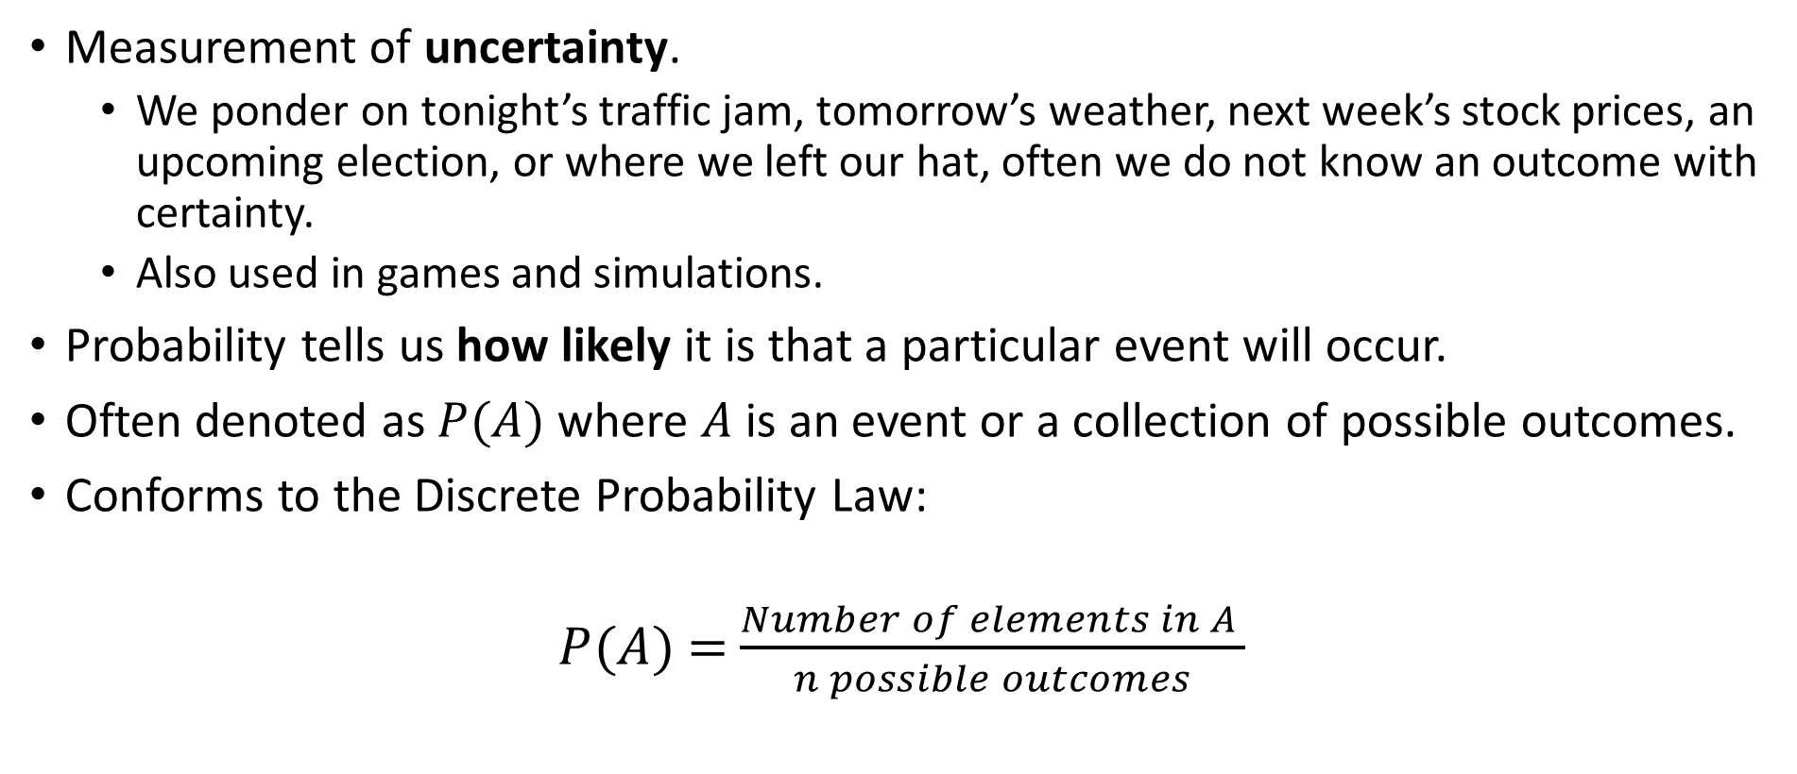
Probability
INTRODUCTION TO COMPUTING
Course Code: CCINCOM/L
Measurement of uncertainty.
We ponder on tonight’s traffic jam, tomorrow’s weather, next week’s stock prices, an upcoming election, or where we left our hat, often we do not know an outcome with certainty.
Also used in games and simulations.
Probability tells us how likely it is that a particular event will occur.
Often denoted as $P(A)$ where $A$ is an event or a collection of possible outcomes.
Conforms to the Discrete Probability Law:
$P$($A$) = $\frac{Number of elements in A }{n possible outcomes}$
Review in Probability, Intro to RL Concepts
Joseph Marvin R. Imperial
REINFORCEMENT LEARNING
NU College of Computing and Information Technologies
Course Code: CCRNFLRL

Slide 3


Example
INTRODUCTION TO COMPUTING
Course Code: CCINCOM/L
The most fundamental stochastic experiment is the experiment where a coin is tossed a number of times, say $n$ times.
Tossing a coin a few times won’t immediately give you a 50% chance for all outcomes. But tossing it many, many times will.
Review in Probability, Intro to RL Concepts
Joseph Marvin R. Imperial
REINFORCEMENT LEARNING
NU College of Computing and Information Technologies
Course Code: CCRNFLRL

Slide 4
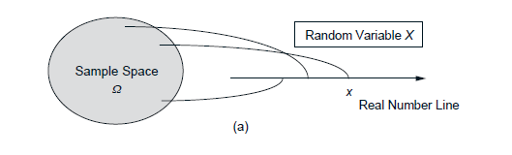

Random Variables
INTRODUCTION TO COMPUTING
Course Code: CCINCOM/L
A particular number which is associated with or depends on the outcomes of a random event.
Mathematically, a random variable is a real-valued function of the experimental outcome.
Denoted as $X$. Thus, we write $P$($X$ = $x$).
Review in Probability, Intro to RL Concepts
Joseph Marvin R. Imperial
REINFORCEMENT LEARNING
NU College of Computing and Information Technologies
Course Code: CCRNFLRL

Slide 5
Example
INTRODUCTION TO COMPUTING
Course Code: CCINCOM/L
In an experiment involving a sequence of 3 tosses of a coin, the number of getting heads H in the sequence is a random variable 𝑋.
𝑃(𝑋 = 0) = 1/8 (T, T, T)
𝑃(𝑋 = 1) = 3/8 (H, T, T), (T, H, T), (T, T, H)
𝑃(𝑋 = 2) = 3/8 (H, H, T), (H, T, H), (T, H, H)
𝑃(𝑋 = 3) = 1/8 (H, H, H)
𝑃(𝑋 ≥ 4) = 0
Review in Probability, Intro to RL Concepts
Joseph Marvin R. Imperial
REINFORCEMENT LEARNING
NU College of Computing and Information Technologies
Course Code: CCRNFLRL

Slide 6
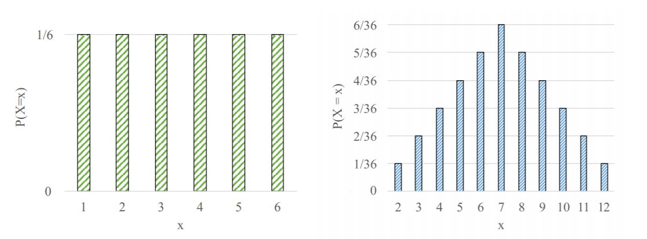
Probability Mass Function (PMF)
INTRODUCTION TO COMPUTING
Course Code: CCINCOM/L
PMF of a random variable is a function that maps possible outcomes of a random variable to the corresponding probabilities.
We can represent PMFs as a formula, a graph, or a table.
Review in Probability, Intro to RL Concepts
P(X = 0) | 1/8
P(X = 1) | 3/8
P(X = 2) | 3/8
P(X = 3) | 1/8
P(X >= 4) | 0
Joseph Marvin R. Imperial
REINFORCEMENT LEARNING
NU College of Computing and Information Technologies
Course Code: CCRNFLRL

Slide 7
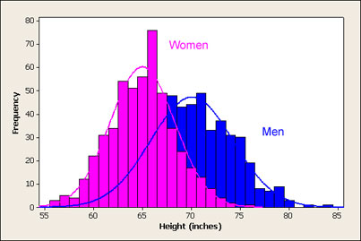
Probability Distributions
INTRODUCTION TO COMPUTING
Course Code: CCINCOM/L
A probability distribution is the mathematical function that gives the probabilities of occurrence of different possible outcomes for an experiment.
Suppose you draw a random sample and measure the heights of the subjects. As you measure heights, you can create a distribution of heights. This type of distribution is useful when you need to know which outcomes are most likely, the spread of potential values, and the likelihood of different results.
Review in Probability, Intro to RL Concepts
Joseph Marvin R. Imperial
REINFORCEMENT LEARNING
NU College of Computing and Information Technologies
Course Code: CCRNFLRL

Slide 8
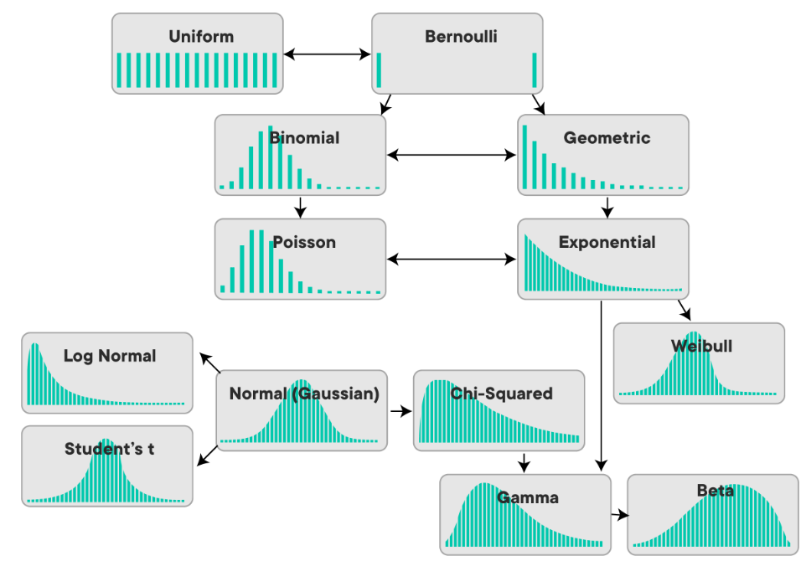
Types of Probability Distributions
INTRODUCTION TO COMPUTING
Course Code: CCINCOM/L
Review in Probability, Intro to RL Concepts
Joseph Marvin R. Imperial
REINFORCEMENT LEARNING
NU College of Computing and Information Technologies
Course Code: CCRNFLRL

Slide 9
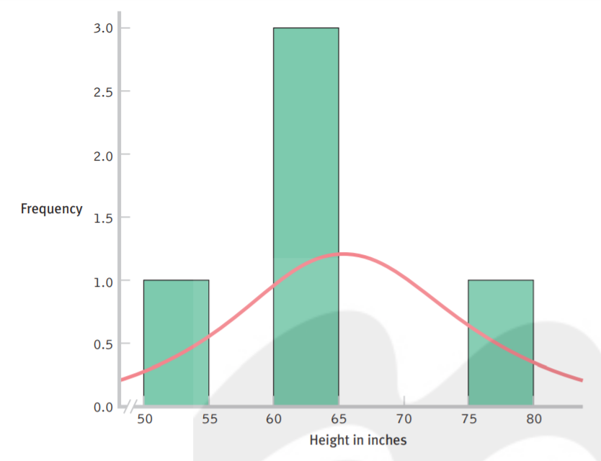
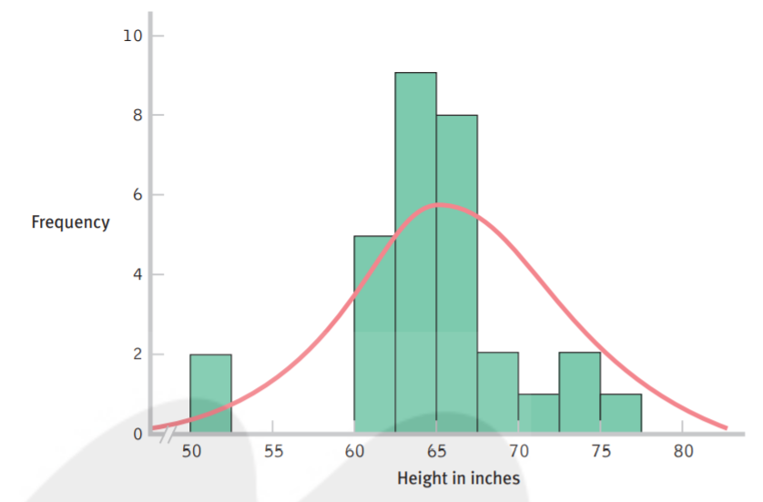
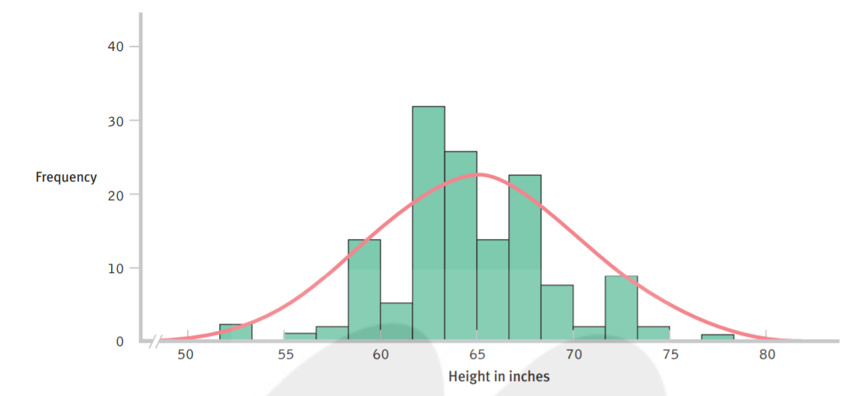
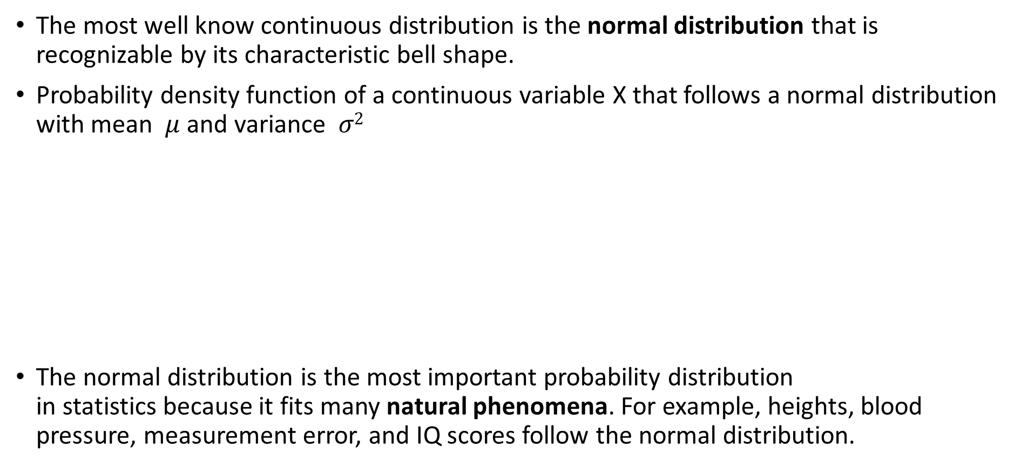
Normal / Gaussian Distribution
INTRODUCTION TO COMPUTING
Course Code: CCINCOM/L
The most well know continuous distribution is the normal distribution that is recognizable by its characteristic bell shape.
Probability density function of a continuous variable X that follows a normal distribution with mean $μ$ and variance $σ2$
The normal distribution is the most important probability distribution in statistics because it fits many natural phenomena. For example, heights, blood pressure, measurement error, and IQ scores follow the normal distribution.
Review in Probability, Intro to RL Concepts
Joseph Marvin R. Imperial
REINFORCEMENT LEARNING
NU College of Computing and Information Technologies
Course Code: CCRNFLRL

Slide 10
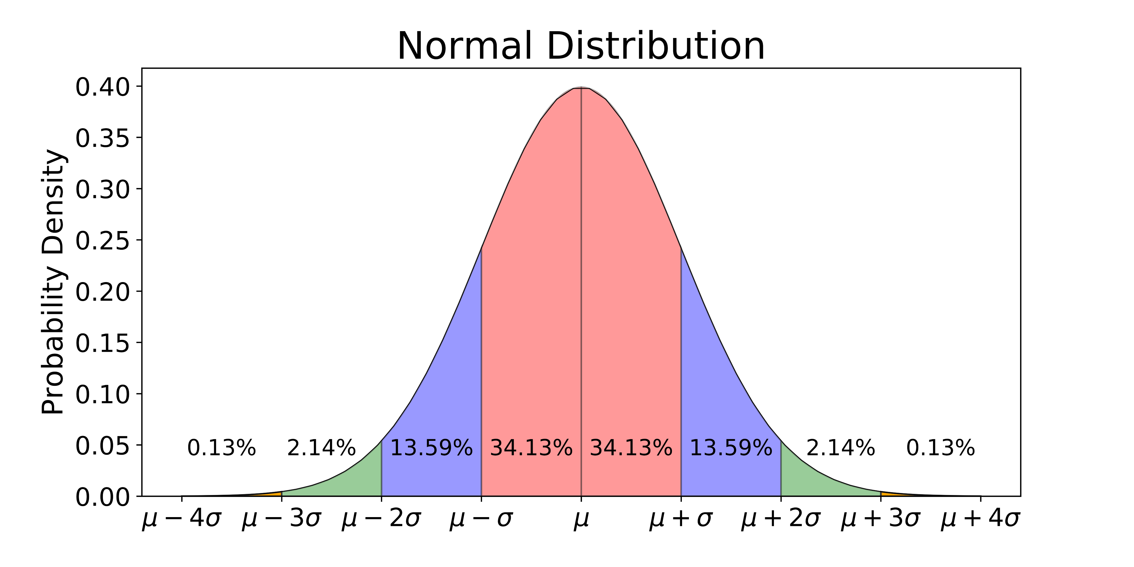
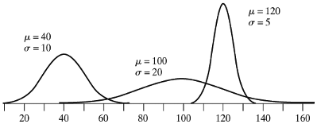
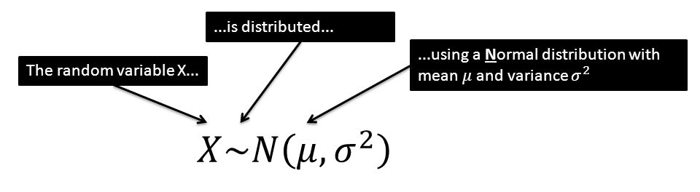
Normal / Gaussian Distribution
INTRODUCTION TO COMPUTING
Course Code: CCINCOM/L
Review in Probability, Intro to RL Concepts
Joseph Marvin R. Imperial
REINFORCEMENT LEARNING
NU College of Computing and Information Technologies
Course Code: CCRNFLRL

Slide 11

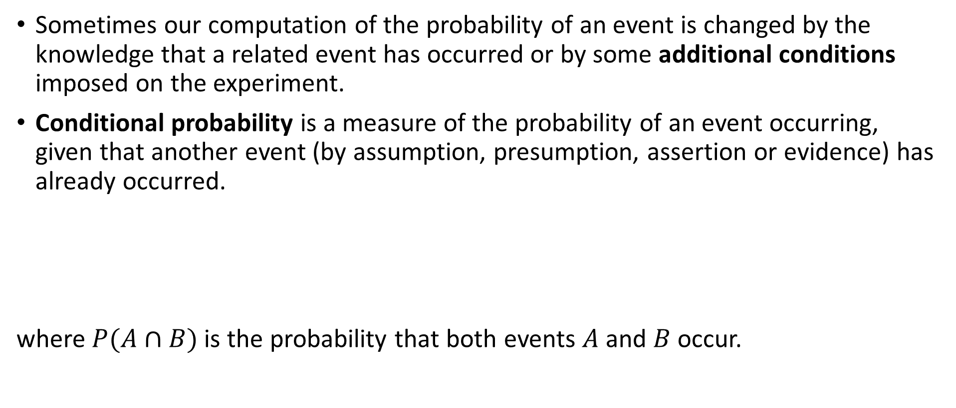
Conditional Probability
INTRODUCTION TO COMPUTING
Course Code: CCINCOM/L
Sometimes our computation of the probability of an event is changed by the knowledge that a related event has occurred or by some additional conditions imposed on the experiment.
Conditional probability is a measure of the probability of an event occurring, given that another event (by assumption, presumption, assertion or evidence) has already occurred.
where $P(A∩B)$is the probability that both events $A$and $B$ occur.
Review in Probability, Intro to RL Concepts
Joseph Marvin R. Imperial
REINFORCEMENT LEARNING
NU College of Computing and Information Technologies
Course Code: CCRNFLRL

Slide 12

Example
INTRODUCTION TO COMPUTING
Course Code: CCINCOM/L
The probability that any given person has a cough on any given day may be only $5\%$. But if we know or assume that the person is sick, then they are much more likely to be coughing.
Thus, the conditional probability that someone unwell is coughing might be $75\%$, in which case we would have that $P(cough) = 5\%$and $P(cough|sick) = 75\%.$
Review in Probability, Intro to RL Concepts
Joseph Marvin R. Imperial
REINFORCEMENT LEARNING
NU College of Computing and Information Technologies
Course Code: CCRNFLRL

Slide 13
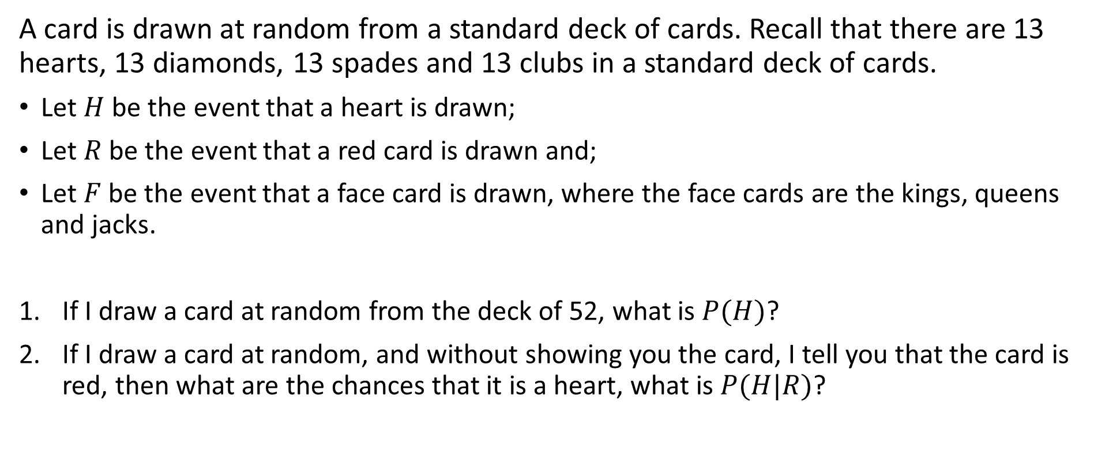
Example
INTRODUCTION TO COMPUTING
Course Code: CCINCOM/L
A card is drawn at random from a standard deck of cards. Recall that there are 13 hearts, 13 diamonds, 13 spades and 13 clubs in a standard deck of cards.
Let $H$ be the event that a heart is drawn;
Let $R$ be the event that a red card is drawn and;
Let $F$ be the event that a face card is drawn, where the face cards are the kings, queens and jacks.
If I draw a card at random from the deck of 52, what is $P(H)$?
If I draw a card at random, and without showing you the card, I tell you that the card is red, then what are the chances that it is a heart, what is $P(H|R)$?
Review in Probability, Intro to RL Concepts
Joseph Marvin R. Imperial
REINFORCEMENT LEARNING
NU College of Computing and Information Technologies
Course Code: CCRNFLRL

Slide 14
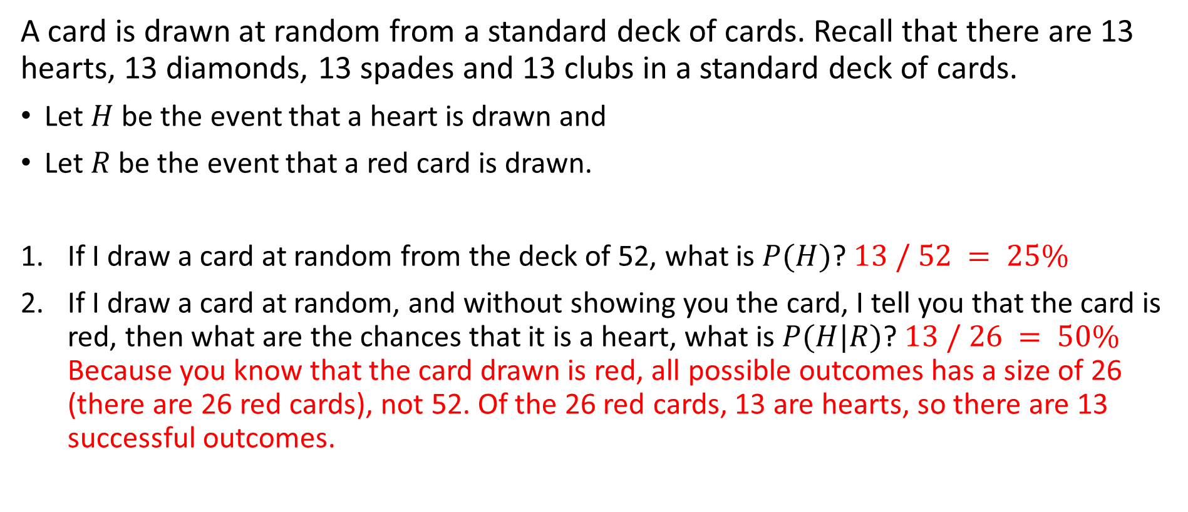
Example
INTRODUCTION TO COMPUTING
Course Code: CCINCOM/L
A card is drawn at random from a standard deck of cards. Recall that there are 13 hearts, 13 diamonds, 13 spades and 13 clubs in a standard deck of cards.
Let $H$ be the event that a heart is drawn and
Let $R$ be the event that a red card is drawn.
If I draw a card at random from the deck of 52, what is $P(H)$? $13 / 52 = 25\%$
If I draw a card at random, and without showing you the card, I tell you that the card is red, then what are the chances that it is a heart, what is $P(H|R)$? $13 / 26 = 50\%$ Because you know that the card drawn is red, all possible outcomes has a size of 26 (there are 26 red cards), not 52. Of the 26 red cards, 13 are hearts, so there are 13 successful outcomes.
Review in Probability, Intro to RL Concepts
Joseph Marvin R. Imperial
REINFORCEMENT LEARNING
NU College of Computing and Information Technologies
Course Code: CCRNFLRL

Slide 15

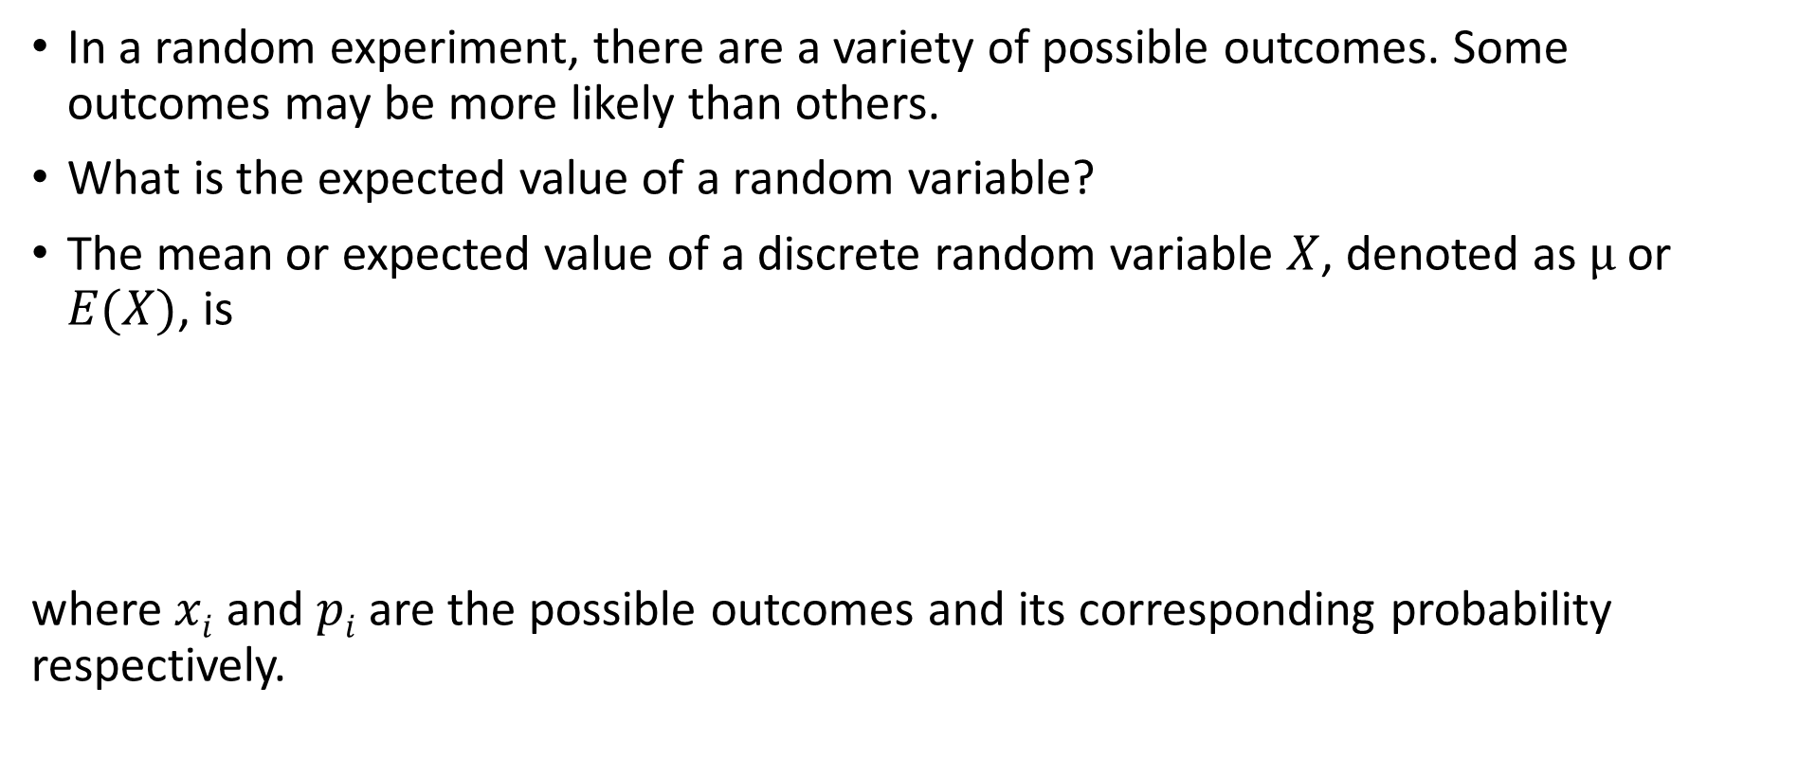
Expectation
INTRODUCTION TO COMPUTING
Course Code: CCINCOM/L
In a random experiment, there are a variety of possible outcomes. Some outcomes may be more likely than others.
What is the expected value of a random variable?
The mean or expected value of a discrete random variable $X$, denoted as $µ$ or $E(X)$, is
where $xi$ and $pi$ are the possible outcomes and its corresponding probability respectively.
Review in Probability, Intro to RL Concepts
Joseph Marvin R. Imperial
REINFORCEMENT LEARNING
NU College of Computing and Information Technologies
Course Code: CCRNFLRL

Slide 16
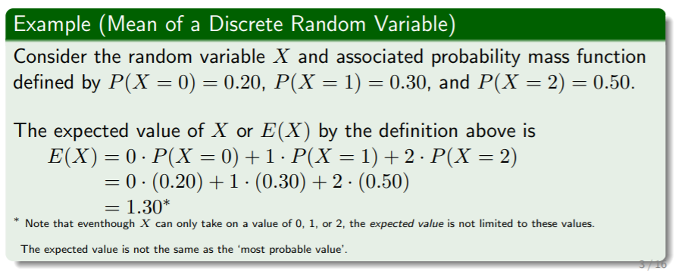
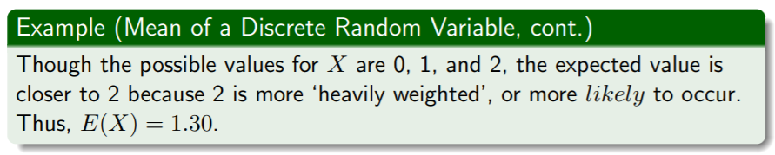
Expectation
INTRODUCTION TO COMPUTING
Course Code: CCINCOM/L
Review in Probability, Intro to RL Concepts
Joseph Marvin R. Imperial
REINFORCEMENT LEARNING
NU College of Computing and Information Technologies
Course Code: CCRNFLRL

Slide 17
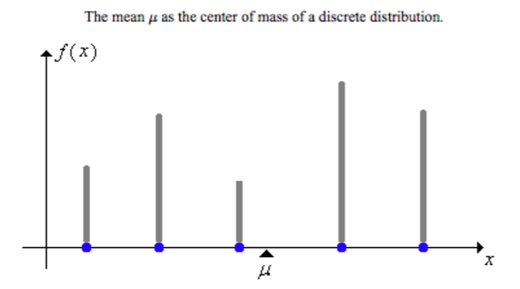
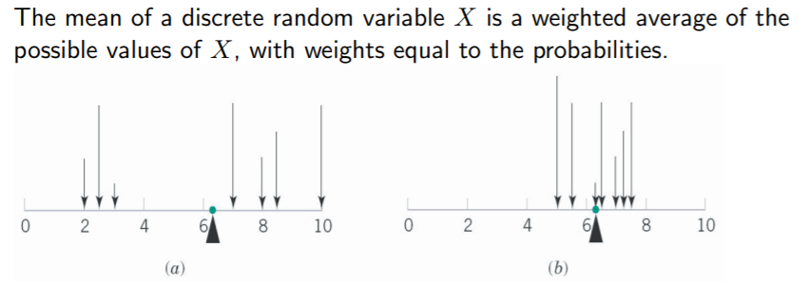
Expectation
INTRODUCTION TO COMPUTING
Course Code: CCINCOM/L
Review in Probability, Intro to RL Concepts
In statistics, the mean or expected value of a random variable is a measure of center for the distribution.
Joseph Marvin R. Imperial
REINFORCEMENT LEARNING
NU College of Computing and Information Technologies
Course Code: CCRNFLRL

